Slide 1

WebRTC
A Brief Overview

Slide 2
What is it?
MediaStream (aka GetUserMedia)
RTCPeerConnection
RTCDataChannel

Slide 3
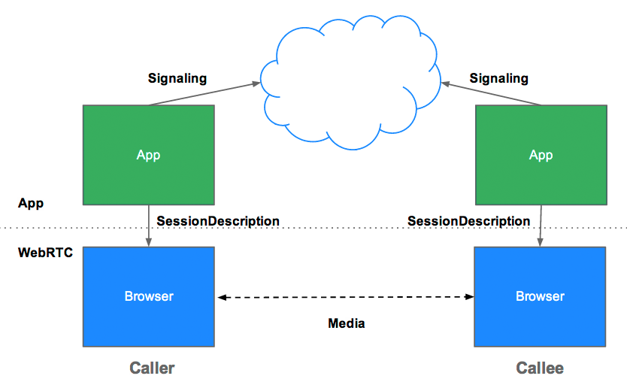
Ideal Diagram

Slide 4
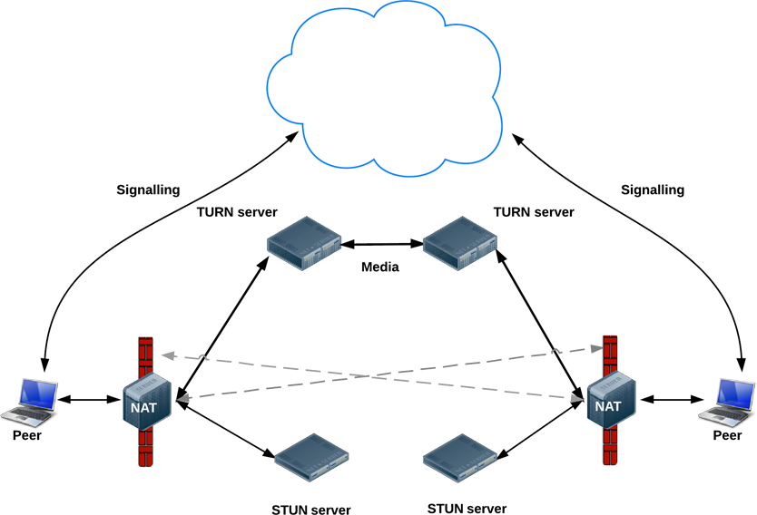
Typical Diagram

Slide 5
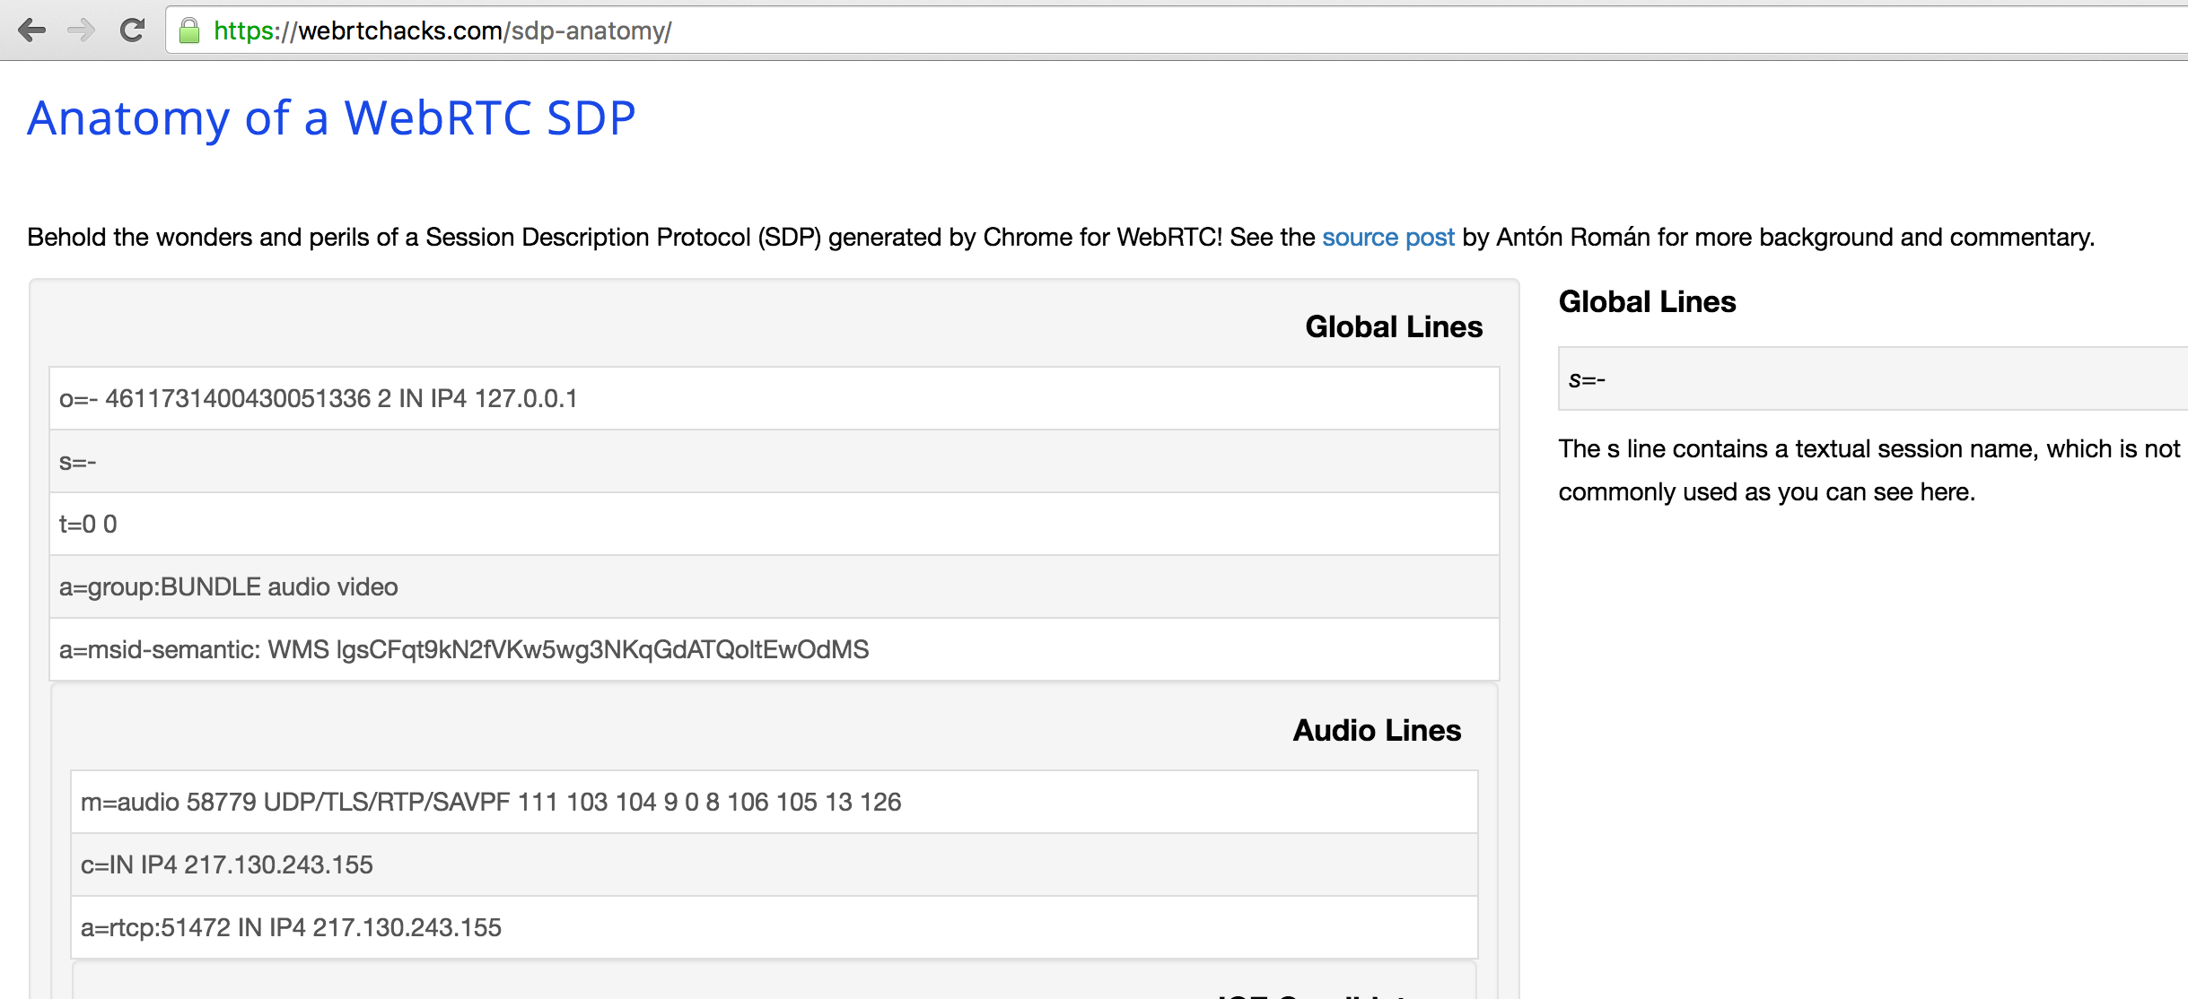
Detail of SDP

Slide 6
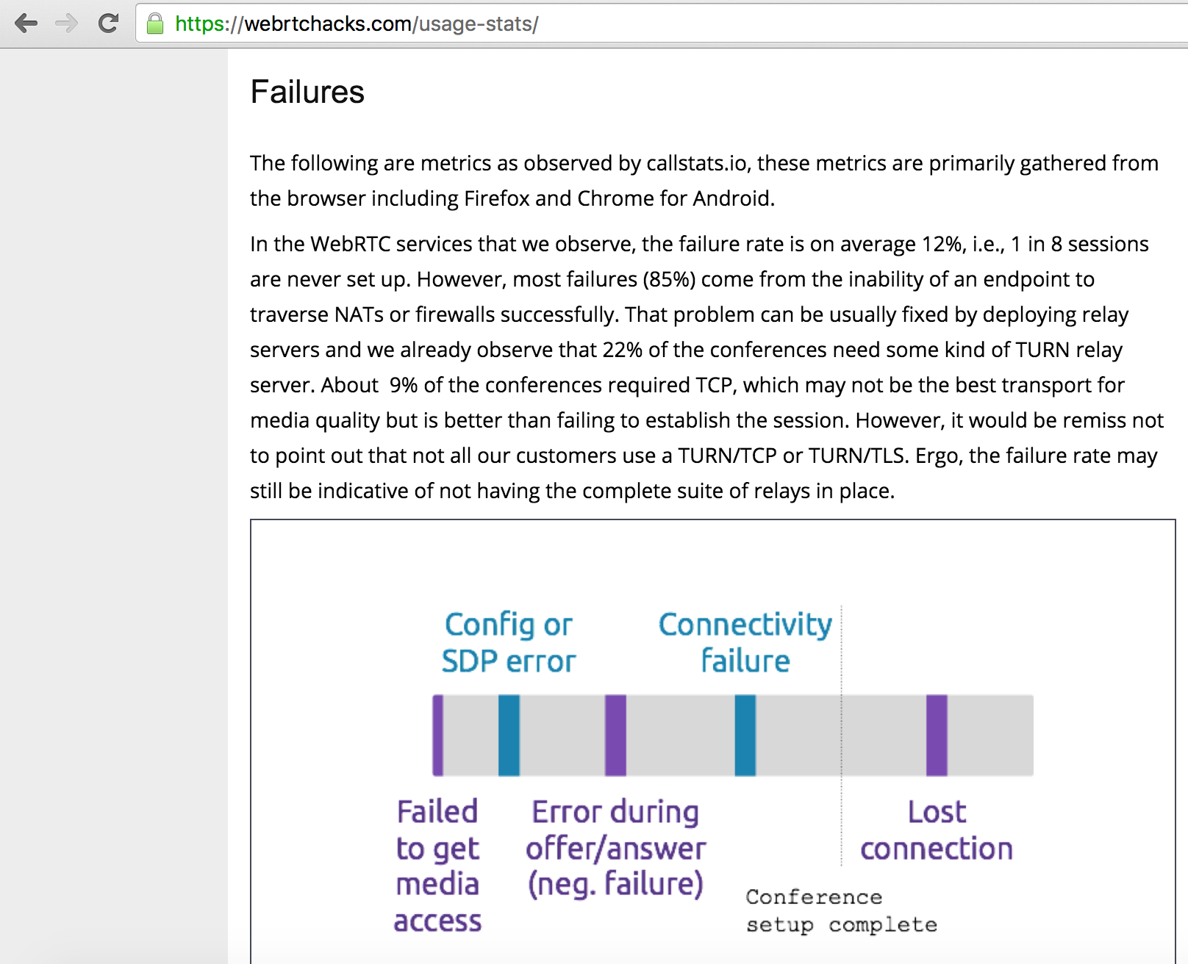
Pitfalls

Slide 7
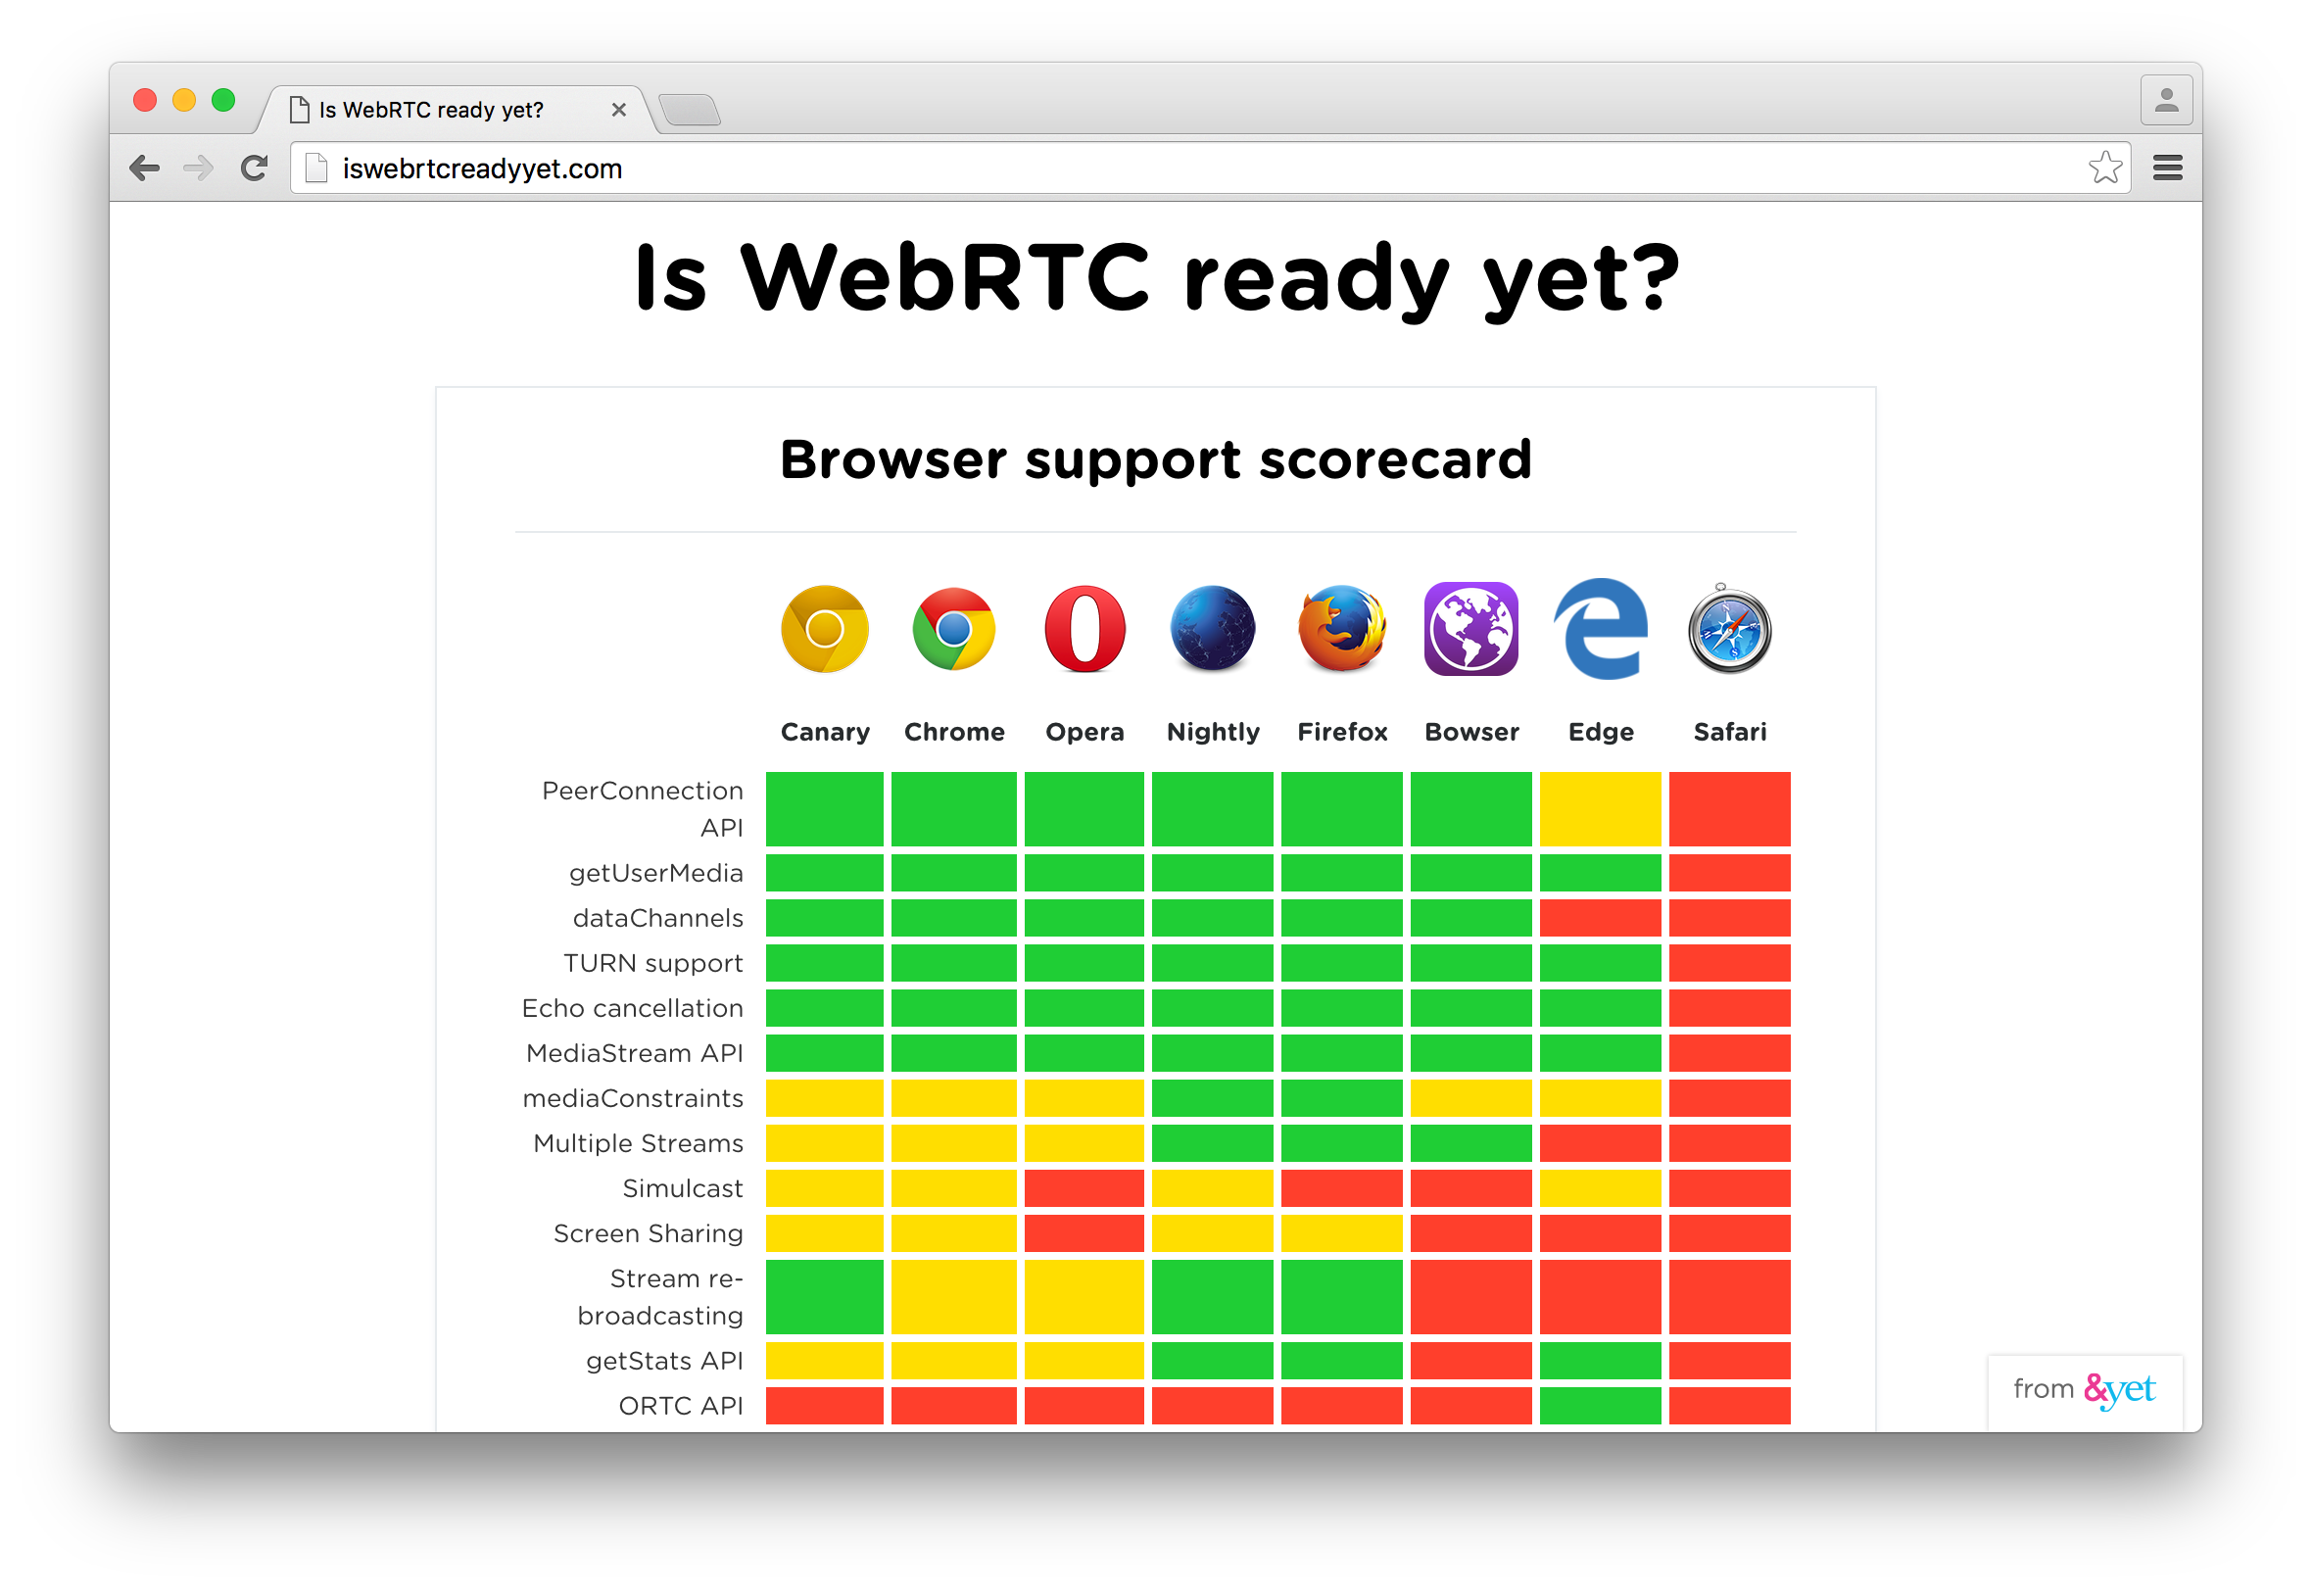
Browser Support

Slide 8
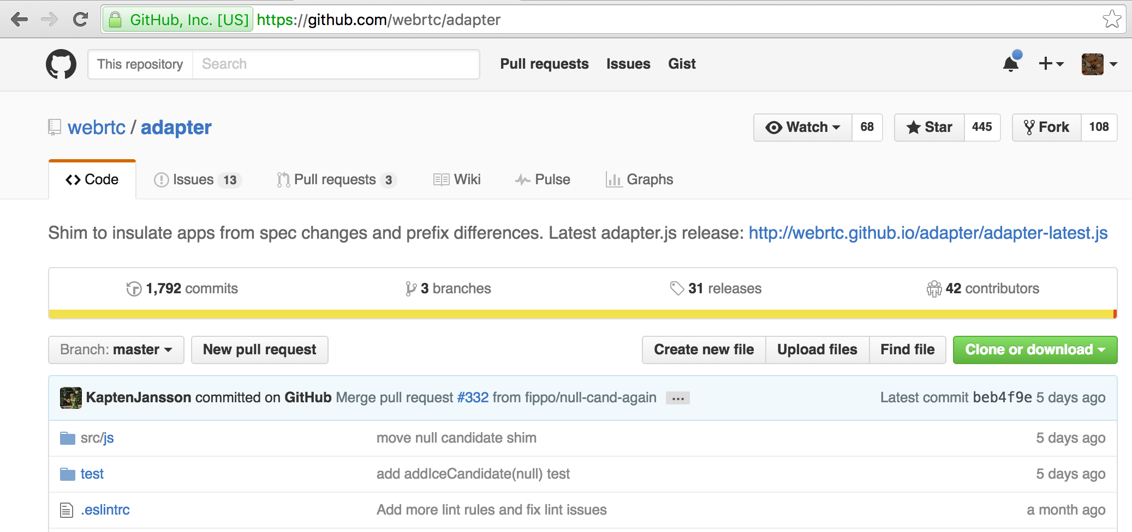
adapter.js shim

Slide 9
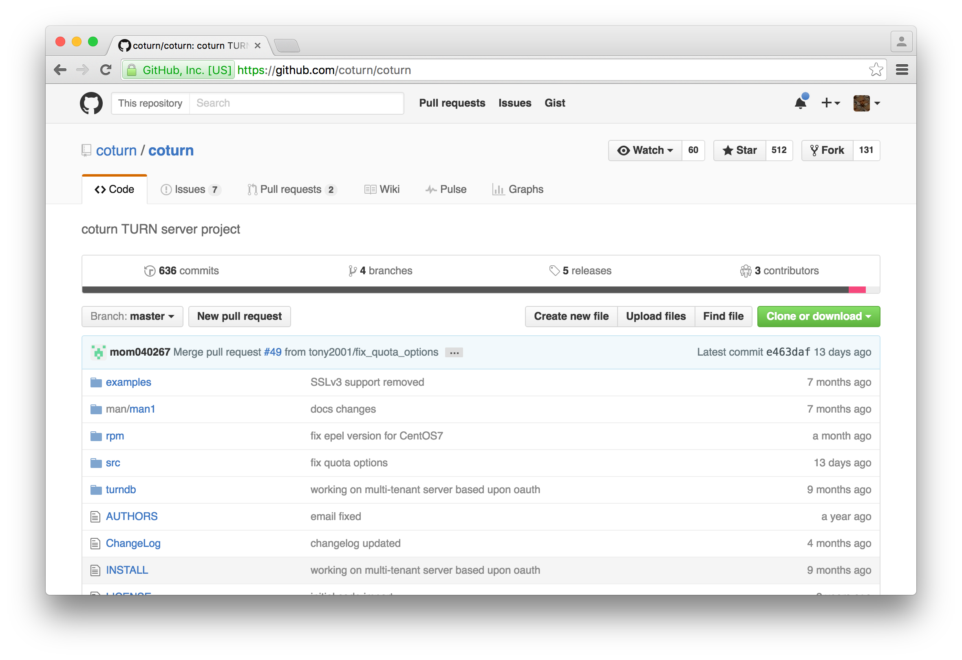
coturn TURN Server

Slide 10
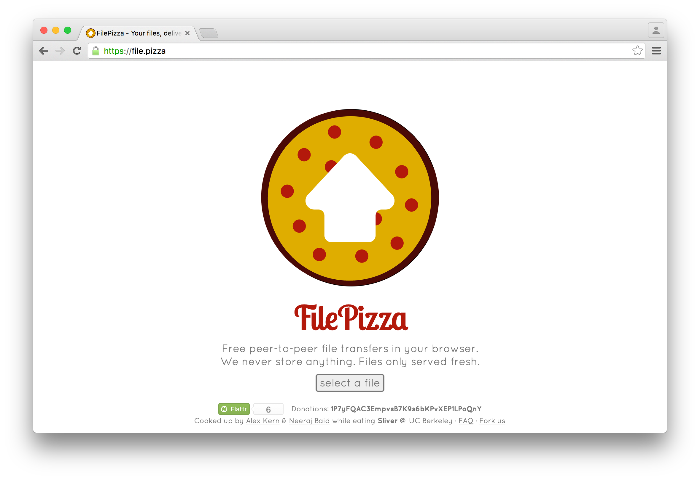
Example

